Slide 1

CS 456: Web Programming
Spring 2022
Lecture 03 – HTML

Slide 2
Summary
Introduction to HTML
Important Tags
HTML Forms
Final Remarks

Slide 3
Introduction to HTML

Slide 4
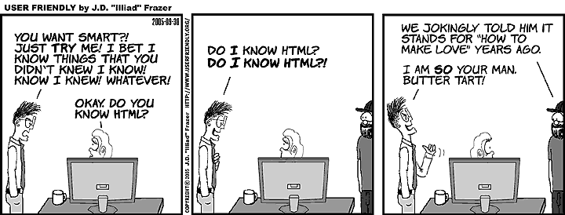
What is HTML?
[ars.userfriendly.org/cartoons/?id=20160930]

Slide 5
What is HTML?
HTML – Hyper Text Markup Language
It is a markup language, that uses tags to mark the text.
HTML is not a programming language. It is a markup language to structure text.
We will always use the newest HTML5 standard.

Slide 6
HTML Pages
HTML page is a simple text file with HTML tags.
Tags are keywords surrounded by < >
Although tags are case-insensitive, always use lower-case for them.
Tags comes in pairs with an opening tag <p> and closing </p>
The main purpose of a Browser is to interpret HTML documents and display them as web pages.

Slide 7
Basic Principles
The entire HTML document must be contained inside the pair tag <html> </html>
Content that is not displayed in the page (e.g., declarations, imports, style creations) must be placed inside <head> </head>
The main content that is going to be displayed must be placed inside the tag pair <body> </body>

Slide 8
Doctype Declaration
Doctype must be the first thing in your HTML document (even before the <html> tag).
Doctype is not a tag, but an instruction for the browser that the document is complying with HTML5.
In HTML5 the instruction is: <!DOCTYPE html>
Since it is not a tag, there is no pair for Doctype.

Slide 9
Basic Structure of an HTML page
Every HTML page should follow this structure:
With the exception of <head> all tags are required.
<!DOCTYPE html>
<html>
<head>
<!-- Elements that will not be displayed -->
</head>
<body>
<!-- Web page body elements -->
</body>
</html>

Slide 10
Comments
There is a special tag to create comments in HTML
The comment begin with <!-- and ends with -->
Everything in between will not be processed (even other HTML tags)
Do not put sensitive information in HTML comments, anyone can see them.
<!-- This is a <h1> Comment </h1> -->

Slide 11
Title
The title tag defines what it is going to be displayed in the browser’s bar for the web page. Only text will be displayed.
Since it is not displayed in the web site (but the top bar), we place this tag inside the <head>.
<head>
<title>
TOP Bar display
</title>
</head>

Slide 12
Tag Meta
This tag provides metadata information about your page.
Meta is not displayed, but it is processed by the browser.
Possible uses: description, keywords, author, last modification, charset
Meta tags should be placed inside the <head> </head>
<meta name="description" content="CS456 Class" /> <meta name="keywords" content="HTML,Tags" /> <meta name="author" content="Henrique Rocha" />
<meta charset="UTF-8" />

Slide 13
Important Tags

Slide 14
Headings
We created headings with the tags <h1> to <h6>.
Use for headings only, and not just to create bigger text; search engines use headings to index web pages.
<h1> CS 456 </h1>
<h2> Web Programming </h2>
<h3> HTML Class </h3>

Slide 15
Paragraphs and Line Breaks
Paragraphs are created with the tags <p> </p>
Line breaks with the empty tag <br />

Slide 16
Empty Tags
Some tags have no content (no text and no tags inside), that is what we called an Empty Tag.
To speed up the writing, we can use the same tag as a opening and closing tag.
Line breaks with an old syntax <br></br>
And a more practical way <br />

Slide 17
Lists
There are two types of lists: ordered lists <ol> (numbered lists) and unordered lists <ul> (bullet lists)
Each item should be placed inside the tags <li> </li>
Techie Movie List
<ul> <!-- change to <ol> to see the difference -->
<li> Pirates of the Silicon Valley </li>
<li> Takedown </li>
<li> The Social Network </li>
</ul>

Slide 18
Tag Attributes
Tags can have different attributes depending on their purpose.
However, every tag has the following attributes
class – the CSS class of this element.
id – a unique identifier for this element (used a lot in JavaScript).
style – for adding CSS style code to this element.
title – a tooltip for the element.
Frameworks like Bootstrap use the attribute “class” to add styles.

Slide 19
Links
We create a link with the tag <a>, and the address is placed in the attribute “href”.
<p> If you have more questions visit the
<a href="http://www.w3.org"> World Wide Web Consortium (W3C) </a> or send na email to <a href="mailto:hsrocha@loyola.edu"> Professor Rocha </a> </p>

Slide 20
Images
The empty tag <img> is used to add an image to the page.
The attribute “src” define the image name and path (always use relative paths). Universally accepted image formats are png, jpg, gif.
You can define the width and height in pixels, cm, or percentage.
The alt attribute displays a text while the image is loading.
In HTML, you cannot place images in the background of another element (you must CSS for that).
<img src="images/my_img_file.png" width="50%" height="50%" alt="My Image"/>

Slide 21
Audio and Video
We use the tags <audio> and <video>; inside those tags we use the tag <source> to define each file for the playlist.
Please avoid using big audio/video files in this course.
For embed youtube videos, open the video on your browser, click on “share” select “embed” and copy the html code to your page.
<audio controls>
<source src="ryu.mp3" type="audio/mpeg"/> </audio>

Slide 22
Divisions <div>
The tag <div> represents a logical division in your document.
We usually use to group together elements and facilitate its style and formatting.
It is also common to set up different id attributes for your divs.
<div id="main">
<h1> CS 456 - Prog.Web </h1>
<p> Example with diferente elements. </p> </div>

Slide 23
HTML Semantic Elements
New tags introduced in HTML5, to group parts of a web page.
Before those tags, the common was to use tags <div id="xyz">
These tags do not perform any formatting.
Semantic Tags: <header>, <nav>, <section>, <article>, <aside>, <footer>.

Slide 24
Table
Create/End a table: <table> </table>, there is a border attribute but if you want more control over it, you need to use CSS.
Table row <tr> </tr>, this element must be inside a <table>
Table data/cell <td></td>, this element must be inside a row.
Inside a cell you can place any other HTML tags.
Always follow this structure <table> <tr> <td> -- you cannot switch the places of <tr> <td>.
Avoid using table to align elements (use CSS for that).

Slide 25
Special Tags for Table
There are more tags (optional ones) that may help when formatting or placing styles for a table.
<thead> it is a division for the header (put your <tr> inside).
<tbody> it is a division for the body of the table (<tr> inside).
<tfoot> it is a division for the footer of the table (<tr> inside).
<th> replaces a <td> for the header cells

Slide 26
Table Example
<table border="1">
<thead>
<tr>
<th>Name</th>
<th>Email</th>
</tr>
</thead>
<tbody>
<tr>
<td>John Doe</td>
<td>jd@johndoe.com</td>
</tr>
<tr>
<td>Jane Doe</td>
<td>jane_doe@jd.com</td>
</tr>
</tbody>
</table>

Slide 27
Attention: Old Attributes and Tags
There are old (deprecated) attributes and tags from previous versions of HTML (before CSS existed).
Tags like <font> and attributes like “color” should not be used, as they are for style formatting and not structuring text.
While they still work, good web designers should avoid using them to make web page compliant with HTML 5.

Slide 28
Why do we follow HTML strict form?
In HTML, a document may work and be displayed by a browser even if it is not compliant with correct specifications.
Then, why should we follow the strict form?
Other HTML readers may not recognize your document and fail.
Therefore, it will be required to always follow the most correct form of HTML in this course.

Slide 29
Good HTML Practices
Always do the following:
Use lowercase letters for filenames, paths, and extensions.
Use relative paths for your resources (files, paths).
Use lowercase letters for tags and attributes.
The values of attributes should be surrounded by double-quotes
Close every tag.
You should not do:
Omit <!DOCTYPE hmtl> or the tags <html> and <body>.
Use spaces in the file names or paths.

Slide 30
Exercise 1
a) Reproduce the web page on the right using good practices of HTML 5 (pay attention to the semantic tag tips)
b) Place meta tags for author, descript, keywords, and charset
c) Add an image in the header to be the logo of this site.

Slide 31
HTML Forms

Slide 32
Introduction to Forms
An HTML Form is a section of document containing special elements called fields or inputs (textfields, buttons, etc.)
Users fill up the form by modifying the input fields (inserting text into a textfield, clicking in a button, etc.)
The form data is sent to an address (usually a server) to be processed in that point.

Slide 33
Forms
We create a from with the tag <form>, and the action attribute has the address which the form will send the data.
Every field must be inside the <form></form> tags, otherwise its data will not be captured and sent.
Most field elements are created using the empty tag <input /> where the attribute type defines how the element will behave.
Few elements use different tags.

Slide 34
Submission Method
Another important attribute in the form deals with the submission method.
The default method is GET which is fast but insecure, all the information can be seem in the address.
A more secure method is POST, where the information can only be captured at the other end. Use method=“post” inside the form tag.

Slide 35
Form Example using GET
<html>
<body style="background-color:#000000;color:#ffffff">
<h1> Example GET Form </h1>
<form action="http://localhost:4444" method="get" >
<p> <label for="fname"> First Name: </label>
<input type="text" name="fname"/> <br/>
<label for="lastname"> Last Name: </label> <input type="text" name="lastname" /> <br/>
<input type="submit" /> </p>
</form>
</body>
</html>

Slide 36
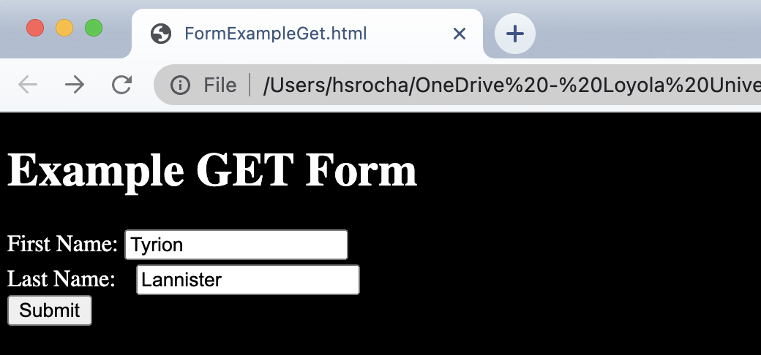
Example Page

Slide 37
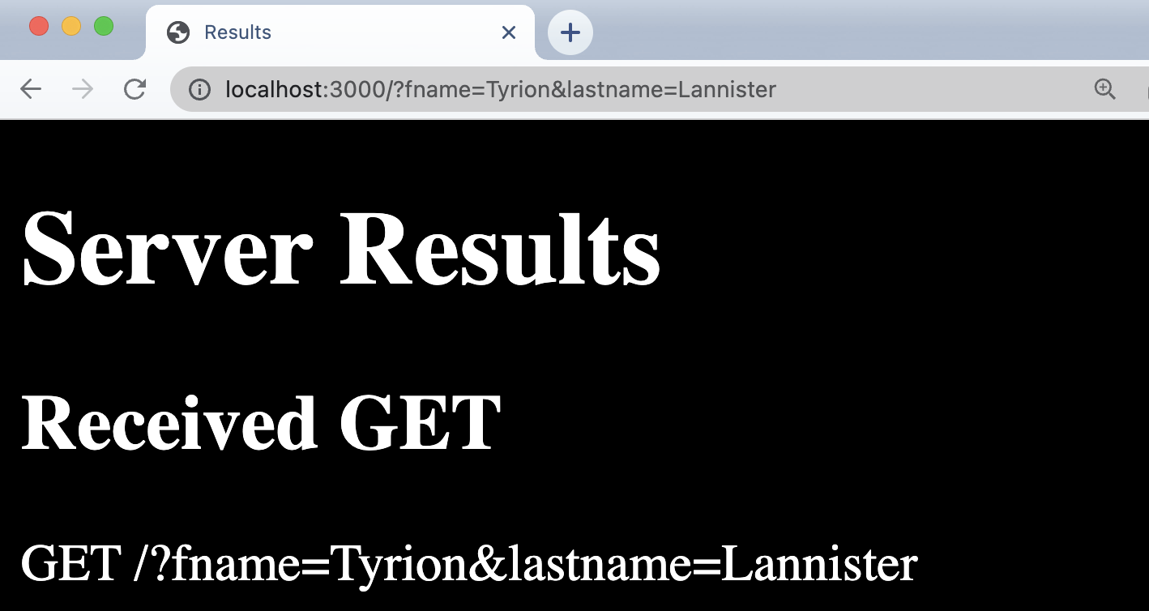
After Sending to the Server

Slide 38
Labels
Use the tag <label> </label> for the labels in the form.
The attribute “for” contains the name of the input field this label is associated with.
<label for="fname"> First Name: </label>
<input type="text" name="fname"/> <br/>

Slide 39
Input Fields
Most of them are the same empty tag <input />
Attribute “name” is required to fetch the value in the server. If you also use an “id” attribute, it is a good practice to have the name and id to share the same value.
Attribute “type” defines what the input will look like and the data it can receive.
Attribute “value” defines an initial value for the input. Or, in case of buttons, it specified the text inside the Button.

Slide 40
Text Inputs
Textfield: <input type=“text” />
Email: <input type=“email” />
URL: <input type=“url” />
Phone: <input type=“tel” />
Password: <input type=“password” /> (always use post with passwords)

Slide 41
Number and Range TextFields
Number: <input type="number" />
This input only accept numbers.
Range: <input type="range" min="0" max="10" />
Creates a slide bar, use the attributes “min” and “max” the set the range otherwise the default is 0 to 100.
The attribute step defines the step of the slide bar.

Slide 42
TextArea
TextArea: <textarea rows=“5” cols=“40”> Initial text you want in the textarea with tags <br/> disabled. Don’t forget to place “name” attributes for your server and “id” for Javascript in your form inputs </textarea>

Slide 43
Buttons
Submit Button: <input type="submit" />
Reset Button (clear the form): <input type="reset" />
JS Button: <input type="button" value="JS Button" onclick=" " />
Custom Button: <button type="submit"> <h1> Custom Button </h1> </button>
Image (Submit) Button: <input type="image" src="images/my_btn.png" />

Slide 44
Checkbox
<input type=“checkbox” name=“chk_email” checked />
The checked attribute makes the checkbox initially marked.
<input type="checkbox" name="chk_email" checked /> <label for="chk_email">Click here if you do not want to received out emails.</label>

Slide 45
Radio Button
Every radio in the same group, should have the same “name” attribute but with different “value” attributes.
Payment Options:
<input type="radio" name="payment" id="rd1" value="credit"/> <label for="rd1">Credit Card</label>
<input type="radio" name="payment" id="rd2" value="transfer"/> <label for="rd2">Bank Transfer</label>
<input type="radio" name="payment" id="rd3" value="crypto" /> <label for="rd3">Crytocurrency</label>

Slide 46
Combo Box
We create a combobox with the tag <select>, the attribute name must be placed inside this tag.
Inside the select, each combo option is made with the tag <option>, and the attribute value defines the return.
Favorite Language:
<select name="language">
<option value="js">JavaScript</option>
<option value="sm">Smalltalk</option>
<option value="java" selected>Java</option>
</select>

Slide 47
Listbox
Identical to a combo box but we place the attribute “multiple” on the <select> tag.
Languages you Know:
<select name="language" multiple>
<option value="js">JavaScript</option>
<option value="sm">Smalltalk</option>
<option value="java">Java</option>
<option value="c">C</option>
</select>

Slide 48
Upload Field
The tag <input type=“file” /> creates a textfield with a button to search your computer for a file.
Usually, this will only send the filename to the server. You will need a framework or JavaScript code to send the actual file.
Attribute “accept” specifies the valid files types.
<label for="flc">Select a picture</label> <input type="file" name="flc" accept="image/*" />

Slide 49
Search Field
Creates a textfield (only) but with a built-in icon to clear the text, tag <input type=“search” />
<label for="search_prod">Product:</label> <input type="search" name="search_prod" />
<button type="submit"> Search </button>

Slide 50
Date and Time Fields
Date: <input type="date" />
Time: <input type="time" />
Datetime: <input type="datetime-local" />
Month: <input type="month" />
Week: <input type="week" />

Slide 51
Color Selection
Color selection is created with the tag <input type="color" />
<label for="selcol">Color:</label> <input type="color" name="selcol"/>

Slide 52
Hidden Field
We can create a hidden field with the tag <input type=“hidden” />
Although the field is not displayed in the page, the information is easily visible in the page source. Therefore, *DO NOT* put sensitive information inside hidden fields.
Why use hidden fields?
Default values, or pre-defined input for the server-side.
User tracking, page tracking.
Store context information in dynamically generated pages.
<input type="hidden" name="id_product" value="42"/>

Slide 53
Input Validation
In HTML5, we can perform validation on the input fields
For more complex validation, JavaScript is needed.
The following are attributes for input that deal with validation:
required: indicate this field is mandatory (i.e., can't be left empty)
pattern: a regular expression the content must comply to be valid.
min: minimum value allowed (only for numbers).
max: maximum value allowed (only for numbers).
minlength: minimum length (in characters) for this input.
maxlength: maximum length (in characters) for this input.

Slide 54
Example of Input Validation
<form action="localhost:3000" method="post">
<label for="txt_name"> Name: </label> <input type="text" name="txt_name" required minlength="10"/><br/>
<label for="txt_email"> E-mail: </label> <input type="email" name="txt_email" required pattern="[a-z0-9._%+-]+@[a-z0-9.-]+\.[a-z]{2,3}$"/> <br/>
<input type="reset"/> <input type="submit" />
</form>

Slide 55
More Input Attributes
The following attributes for <input> are not very important, but may be help with the usability and display:
autocomplete=“on/off”: if enabled, the browser will give suggestions to fill up this input based on your history. The default is enabled.
autofocus: indicates if this element should start with the focus when the page is loaded.
placeholder=“text”: it will display the text defined in placeholder in a lighter-gray when the input is empty.
size=“number”: the size of the input field in number of characters.
readonly: indicates the input is immutable by the user.

Slide 56
Final Remarks

Slide 57
References
HTML Tutorial W3Schools <www.w3schools.com/html/default.asp>
HTML Element Reference (list of all tags) http://www.w3schools.com/tags/default.asp
Input Tag reference <https://www.w3schools.com/tags/tag_input.asp>

